Slide 1
Deep Learning
The Past, The Present and The Future of Artificial Intelligence

Slide 2
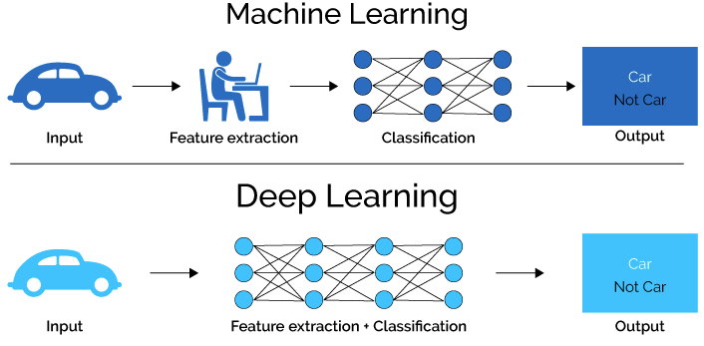
ML vs DL
Notes:
House price prediction

Slide 3
What is Artificial Intelligence
Use of computers to mimic the cognitive functions of humans.

Slide 4

What is Artificial Intelligence
Artificial Narrow Intelligence :
Machine intelligence that equals or exceeds human intelligence at a specific task.
Artificial General Intelligence :
A machine with the ability to apply intelligence to any problem, rather than just one specific problem ( human level intelligence).
Artificial Super Intelligence:
An intellect that is much smarter than the best human brains in practically every field, including scientific creativity, general wisdom, and social skills.

Slide 5
Agenda
Classifying handwritten digits using MLP
Feed Forward Network
Activation Functions
Cost Function and Gradient Calculation
Backpropagation
Convolutional Neural Network
Other Neural Networks

Slide 6
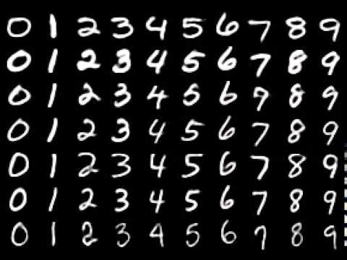
MNIST - The Hello World
Labelled Training Set
60000 Training Images
10000 Test Images
( ,0 )

Slide 7
Feed Forward Network

Slide 8
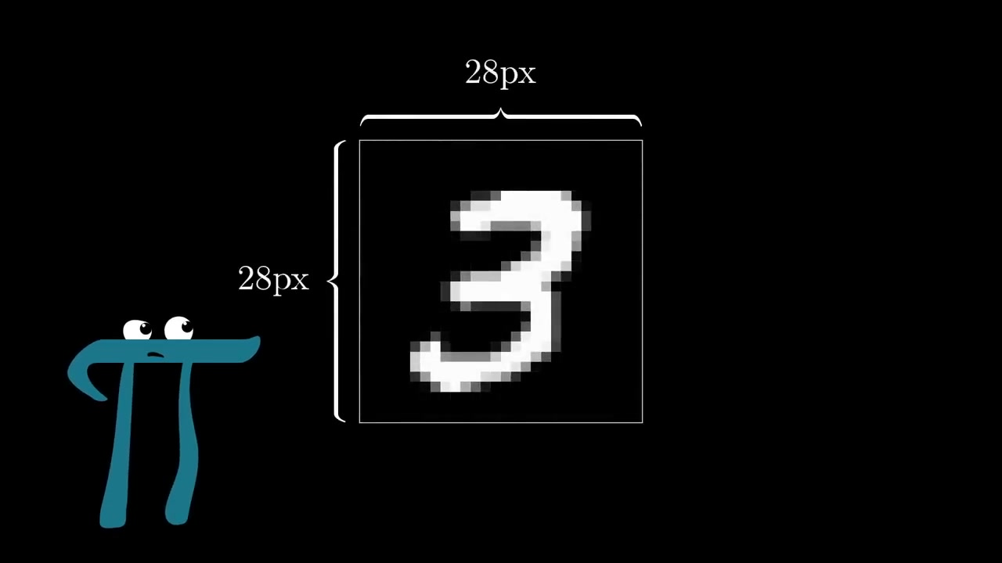
= 784 px
Notes:
Explain about the pixel grid
Intensity of pixels is responsible for creating this image
All images have the same pixel height and width – In different combinations

Slide 9
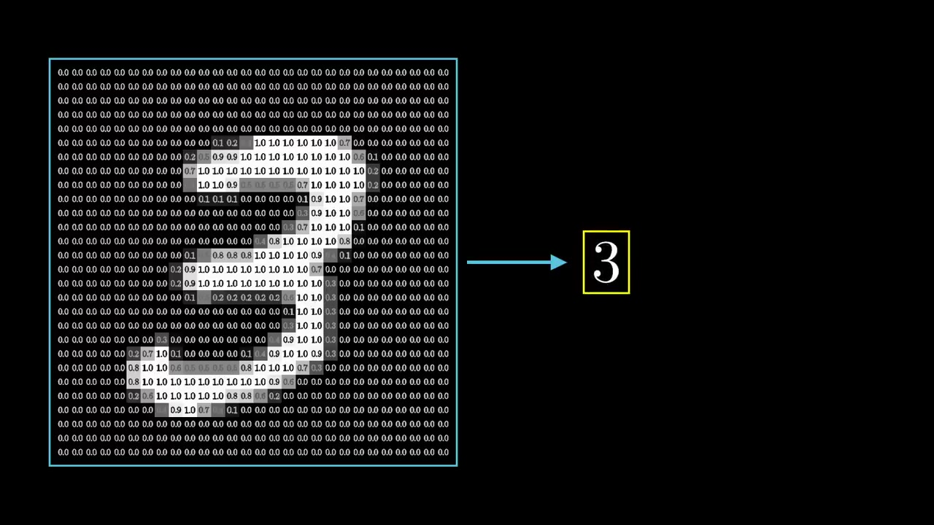
Notes:
Brightness of each pixel is a value between 0 – 1, 1 Being the brightest
Different brightness combinations of these 784 pixels will be responsible for a number in the 28 * 28 grid.

Slide 10
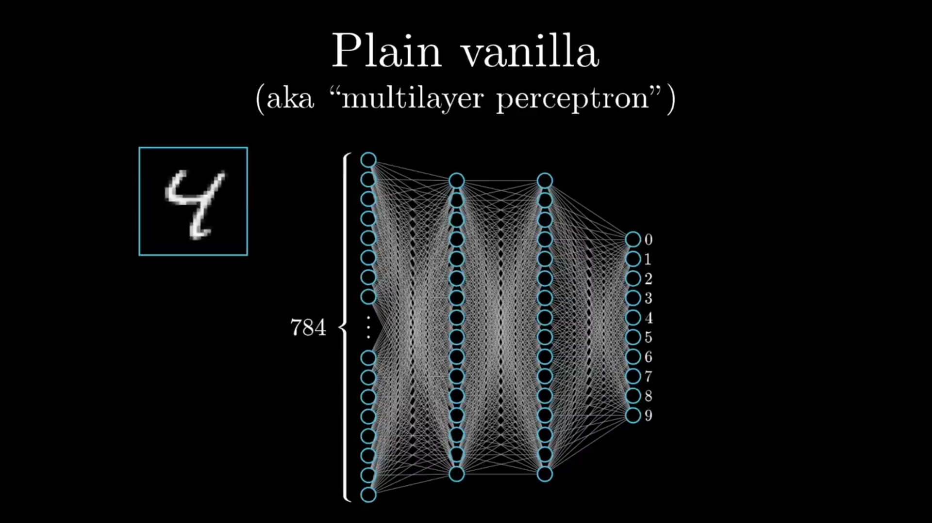
Notes:
MLP is a plain vanilla neural network – 28*28 = 784 pixels are flattened out here as a single column matrix
Don’t explain about the layers

Slide 11
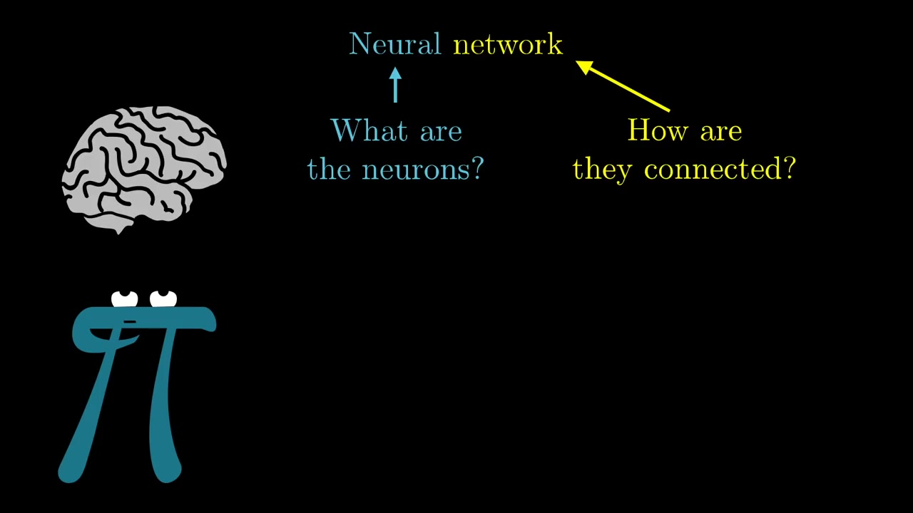
Notes:
Skip

Slide 12
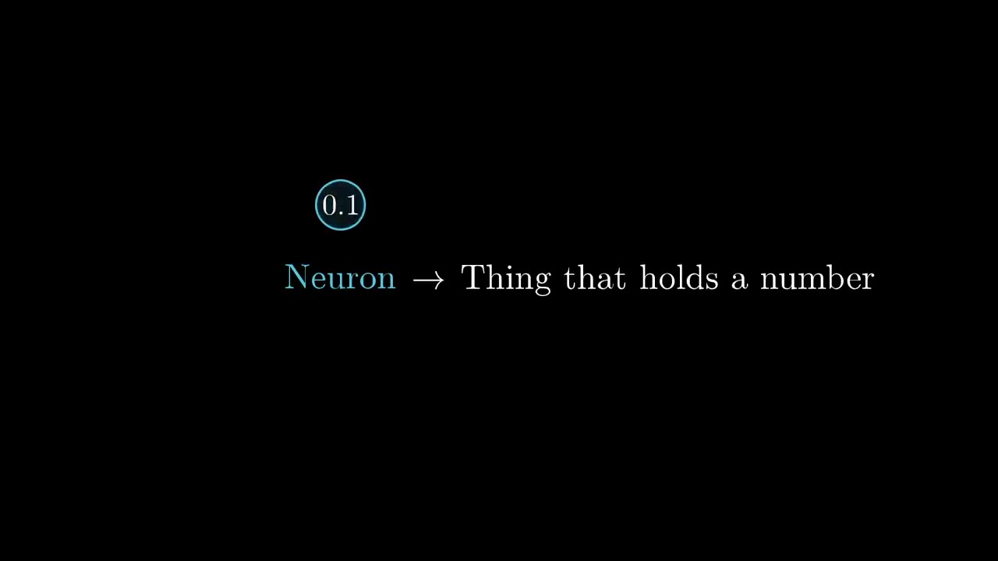
Notes:
For the time being

Slide 13
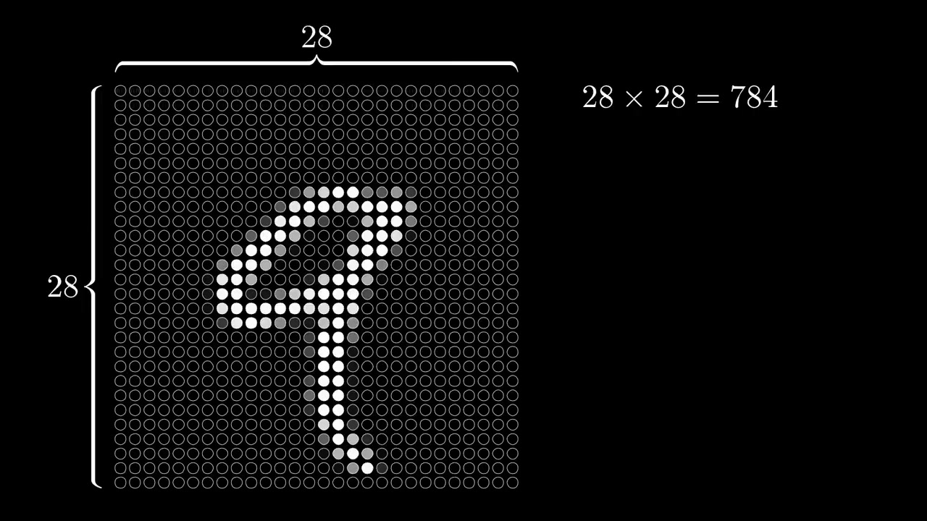
Notes:
Now, every single pixels in this 28 grid system is a neuron holding a value, Skip

Slide 14
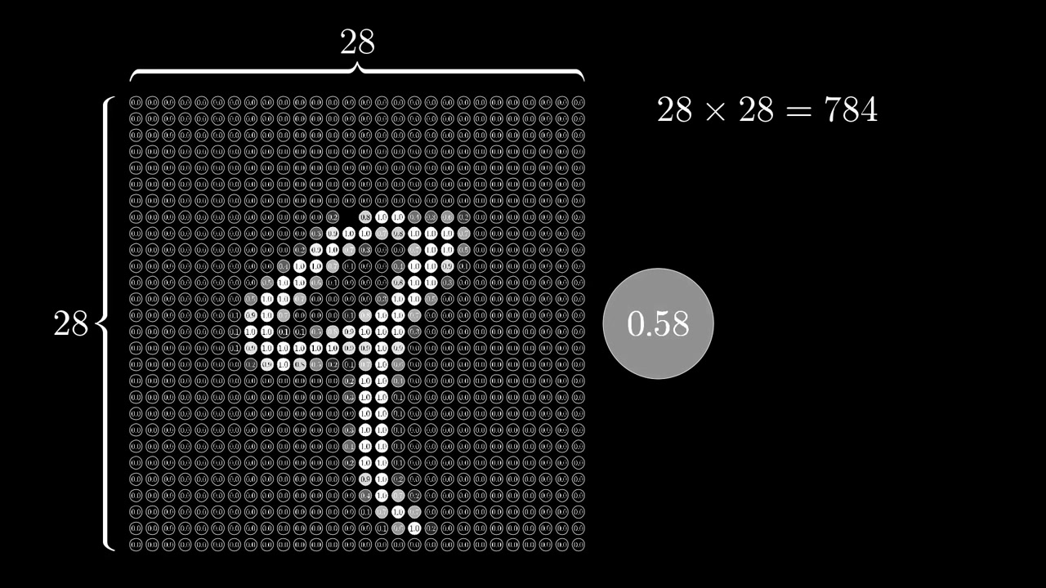
Notes:
Most importantly, the value of this neuron is between 0 and 1.
0 Dark, 1 White

Slide 15
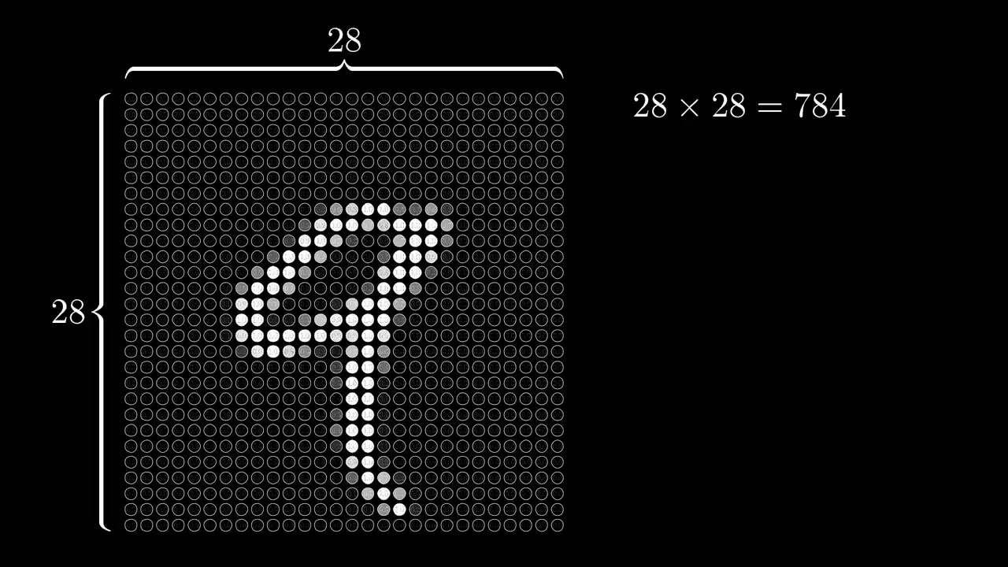
Notes:
I flatten this 28*28 grid to a single column matrix of 784 columns.

Slide 16
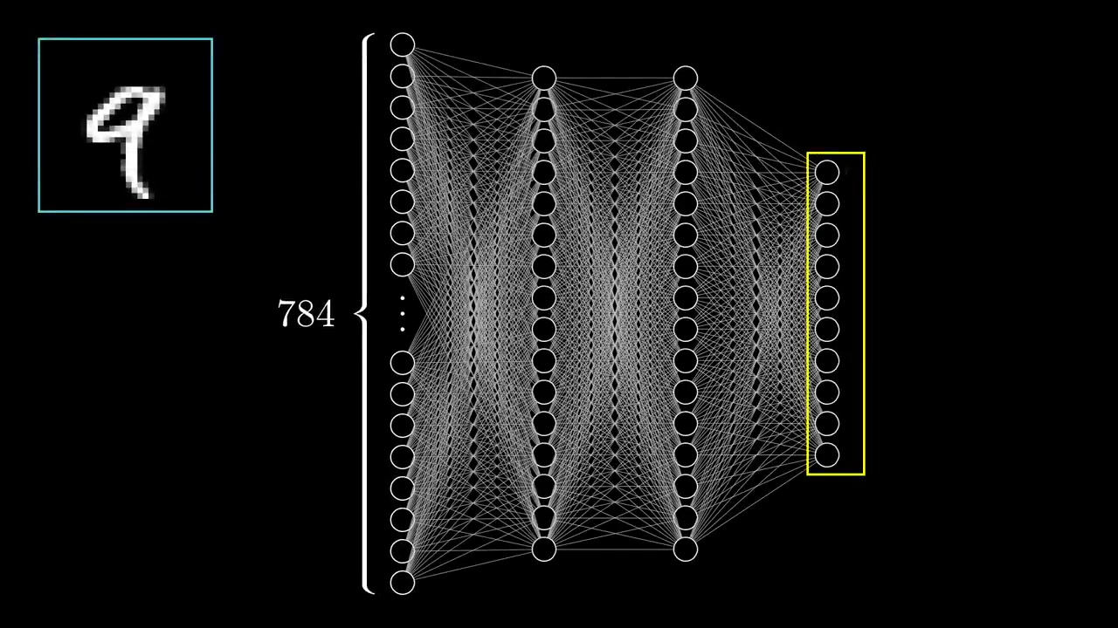
Notes:
The final layer is what we are interested in 10 neurons. Each corresponding to <next>

Slide 17
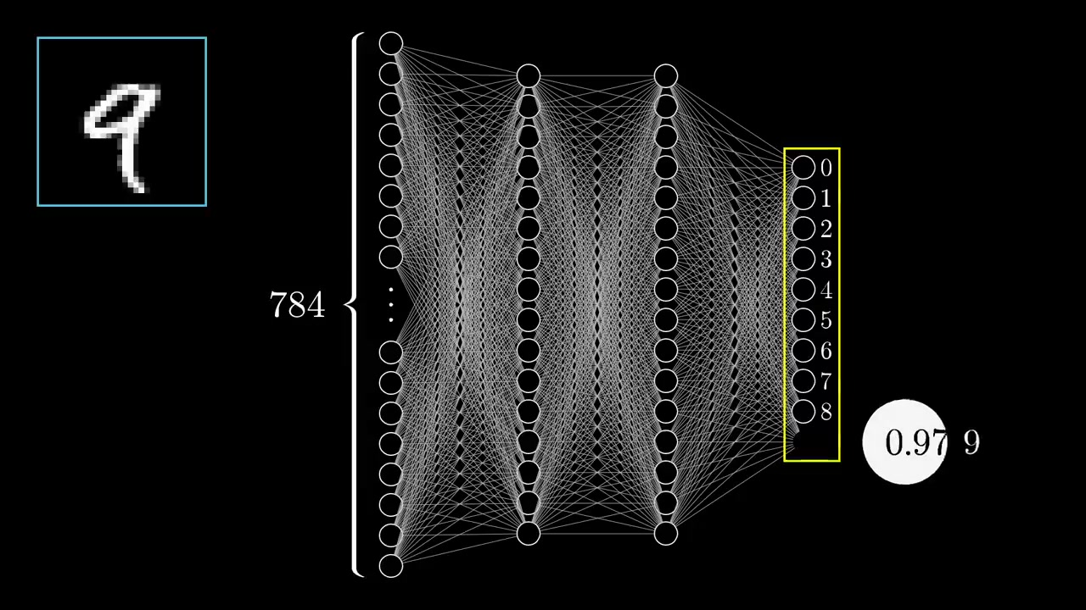
Notes:
A value between 0 and 1. If the last neuron has a value 0.97, and all the other neurons have a value close to zero, it means that we have an accurate prediction

Slide 18
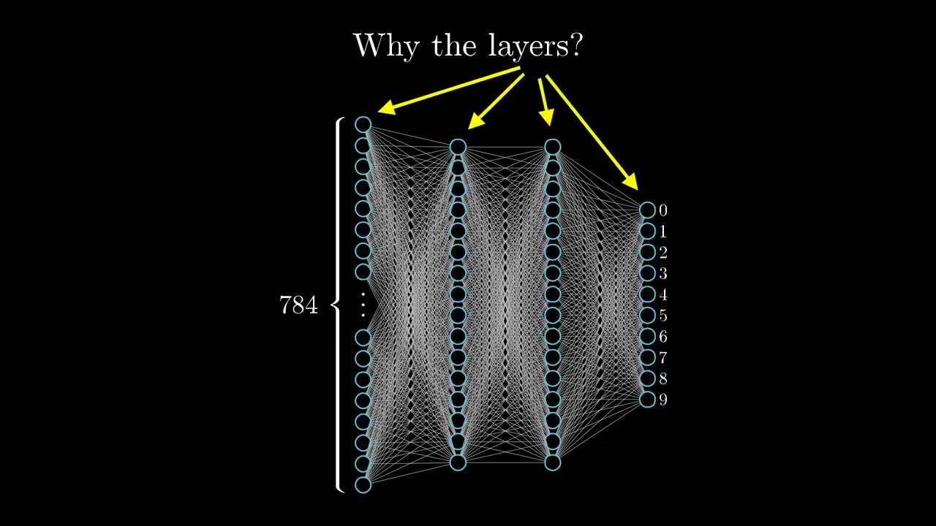
Notes:
Explain 16 was an arbitrary selection and this decision can be done differently also.
As the representation of the data is done mostly by the algorithm itself, It’s hard to explain the actual working. But
If I were to explain how the layers detected something, I would want the network to detect something like this.

Slide 19
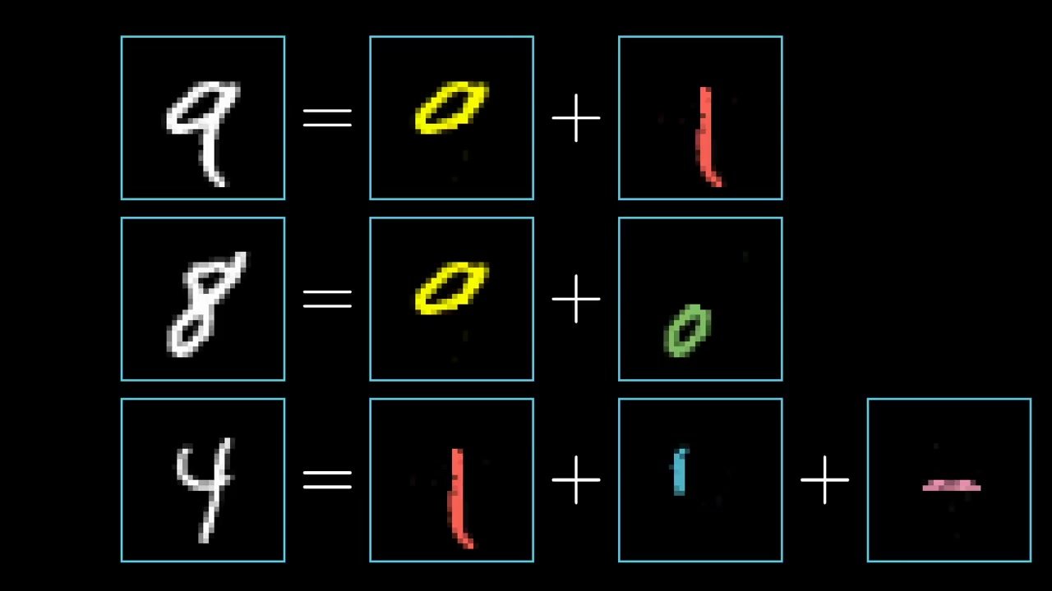

Slide 20
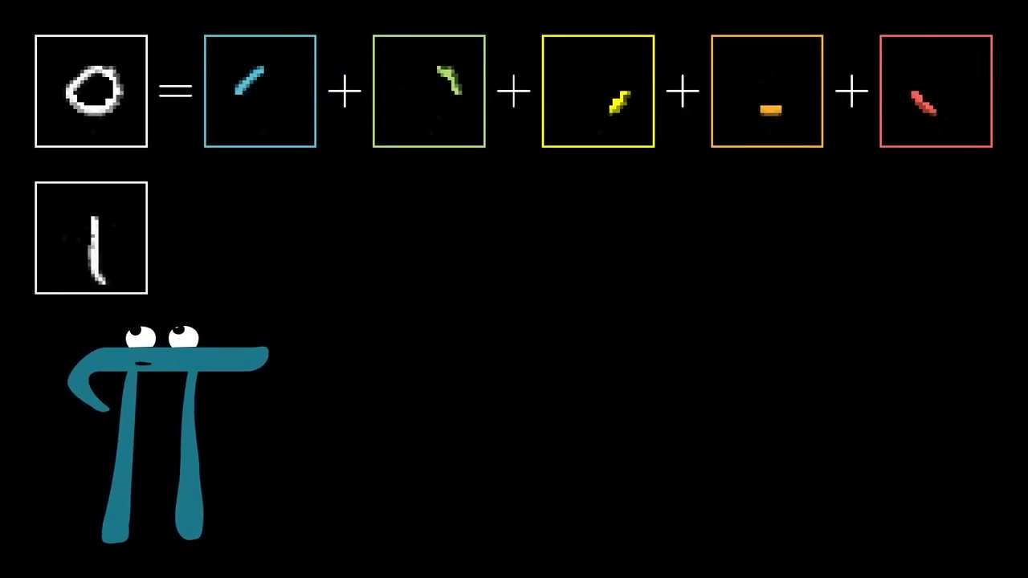
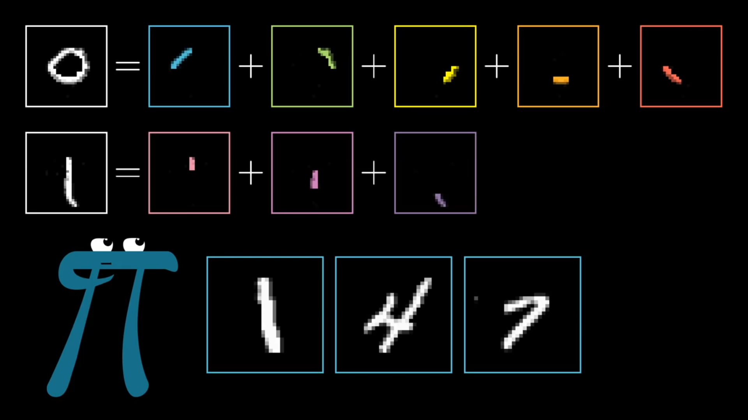

Slide 21
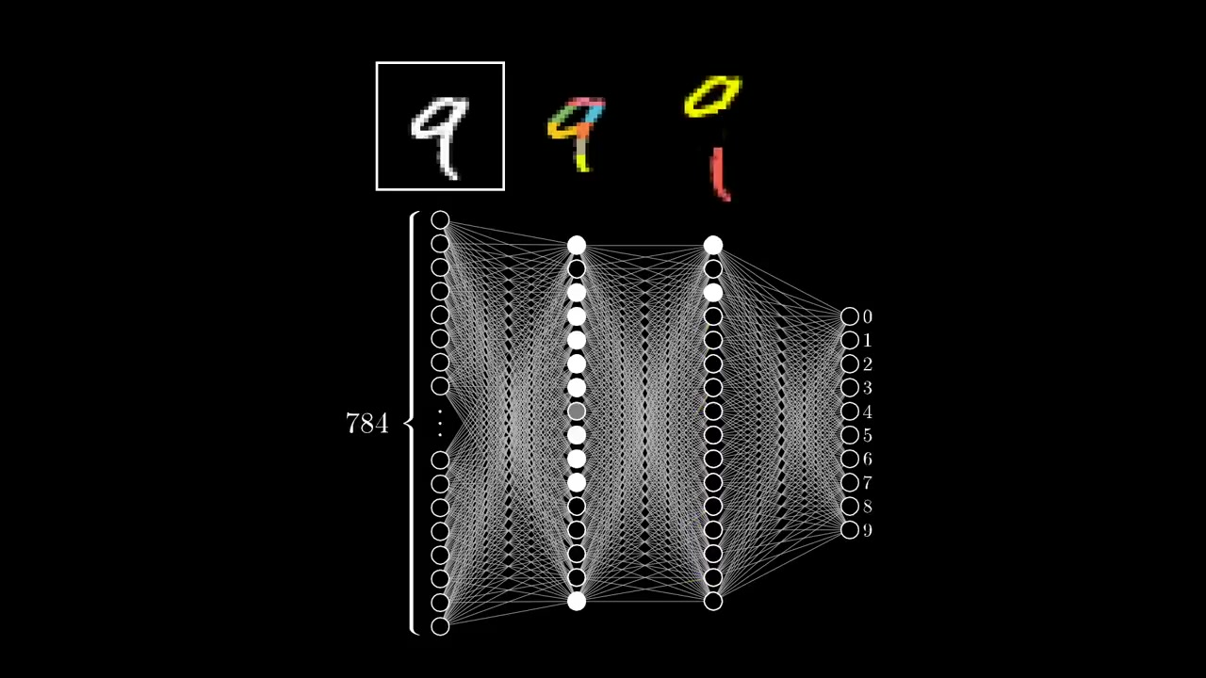

Slide 22
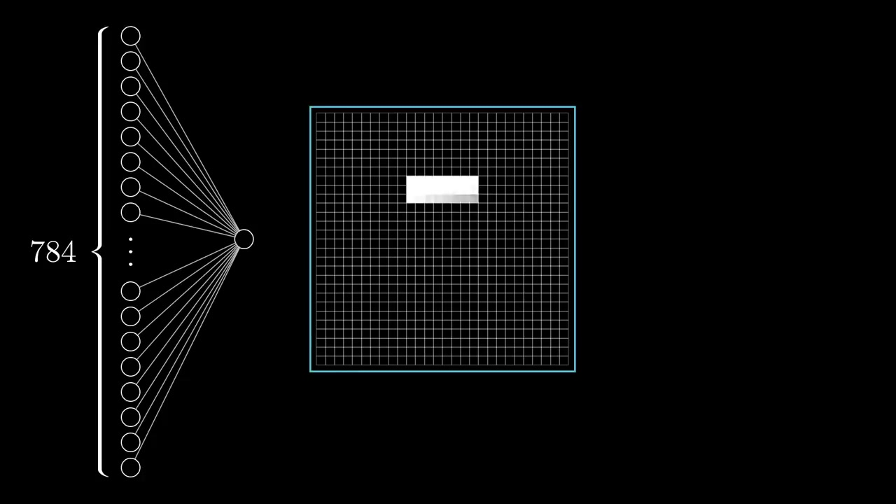
Notes:
One of the detectors in the first layer.
How?

Slide 23
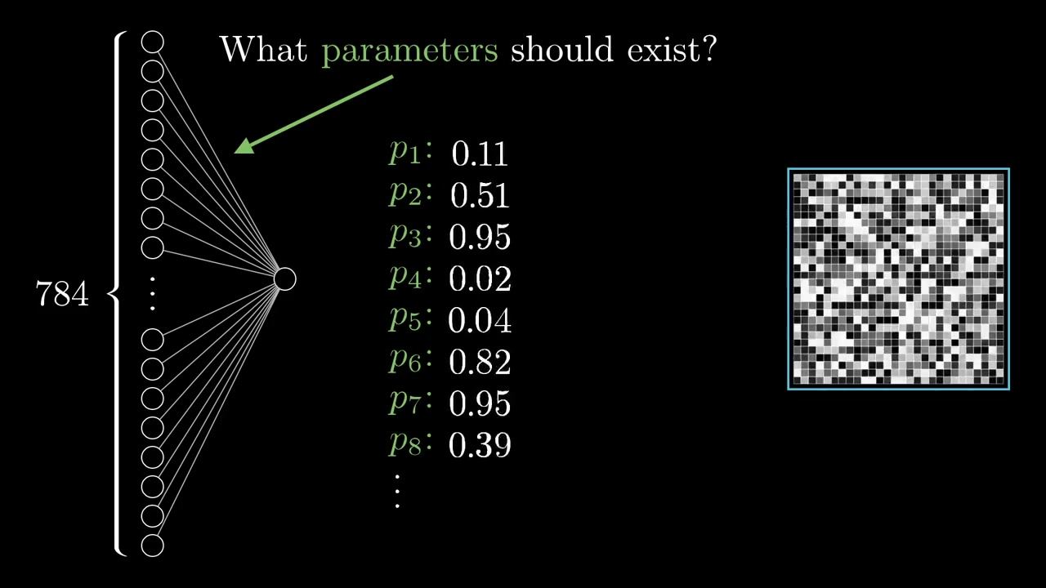

Slide 24
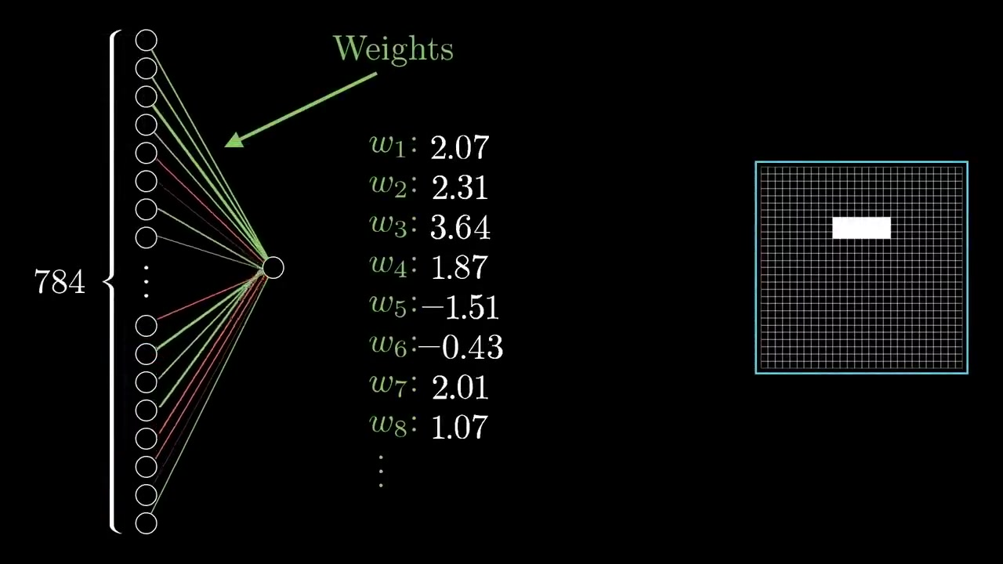

Slide 25
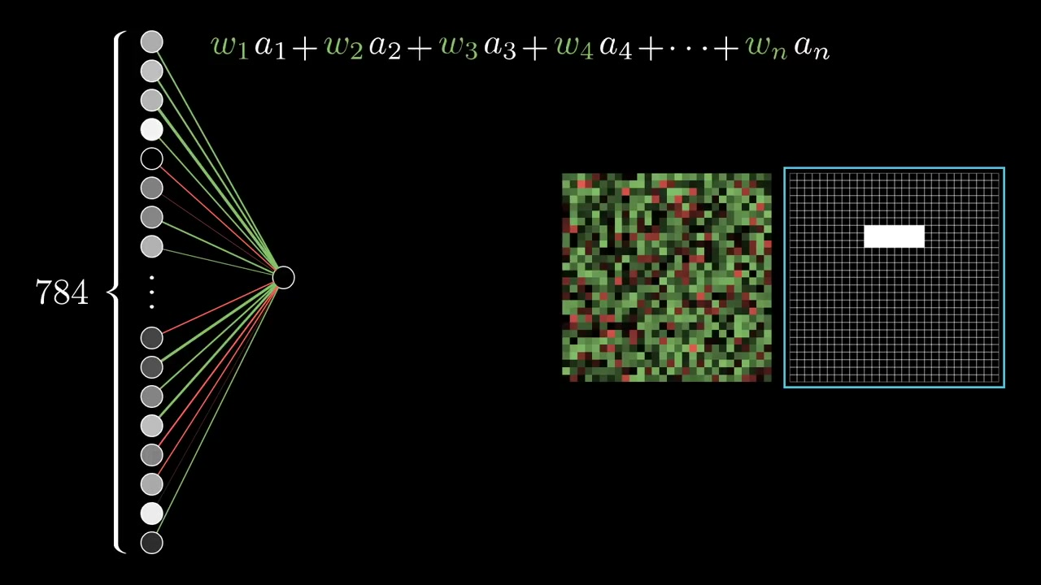

Slide 26
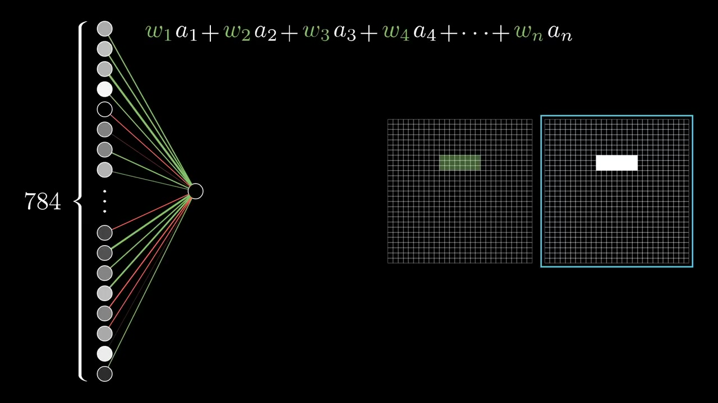

Slide 27
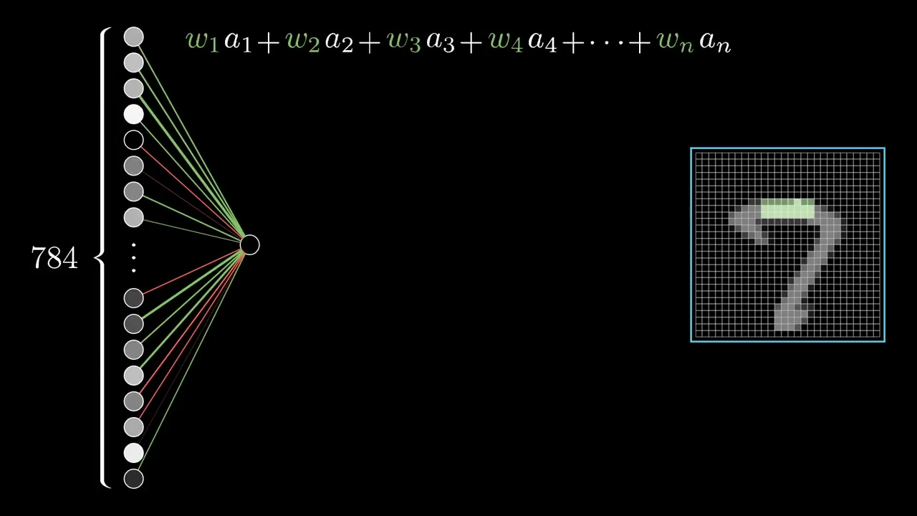

Slide 28
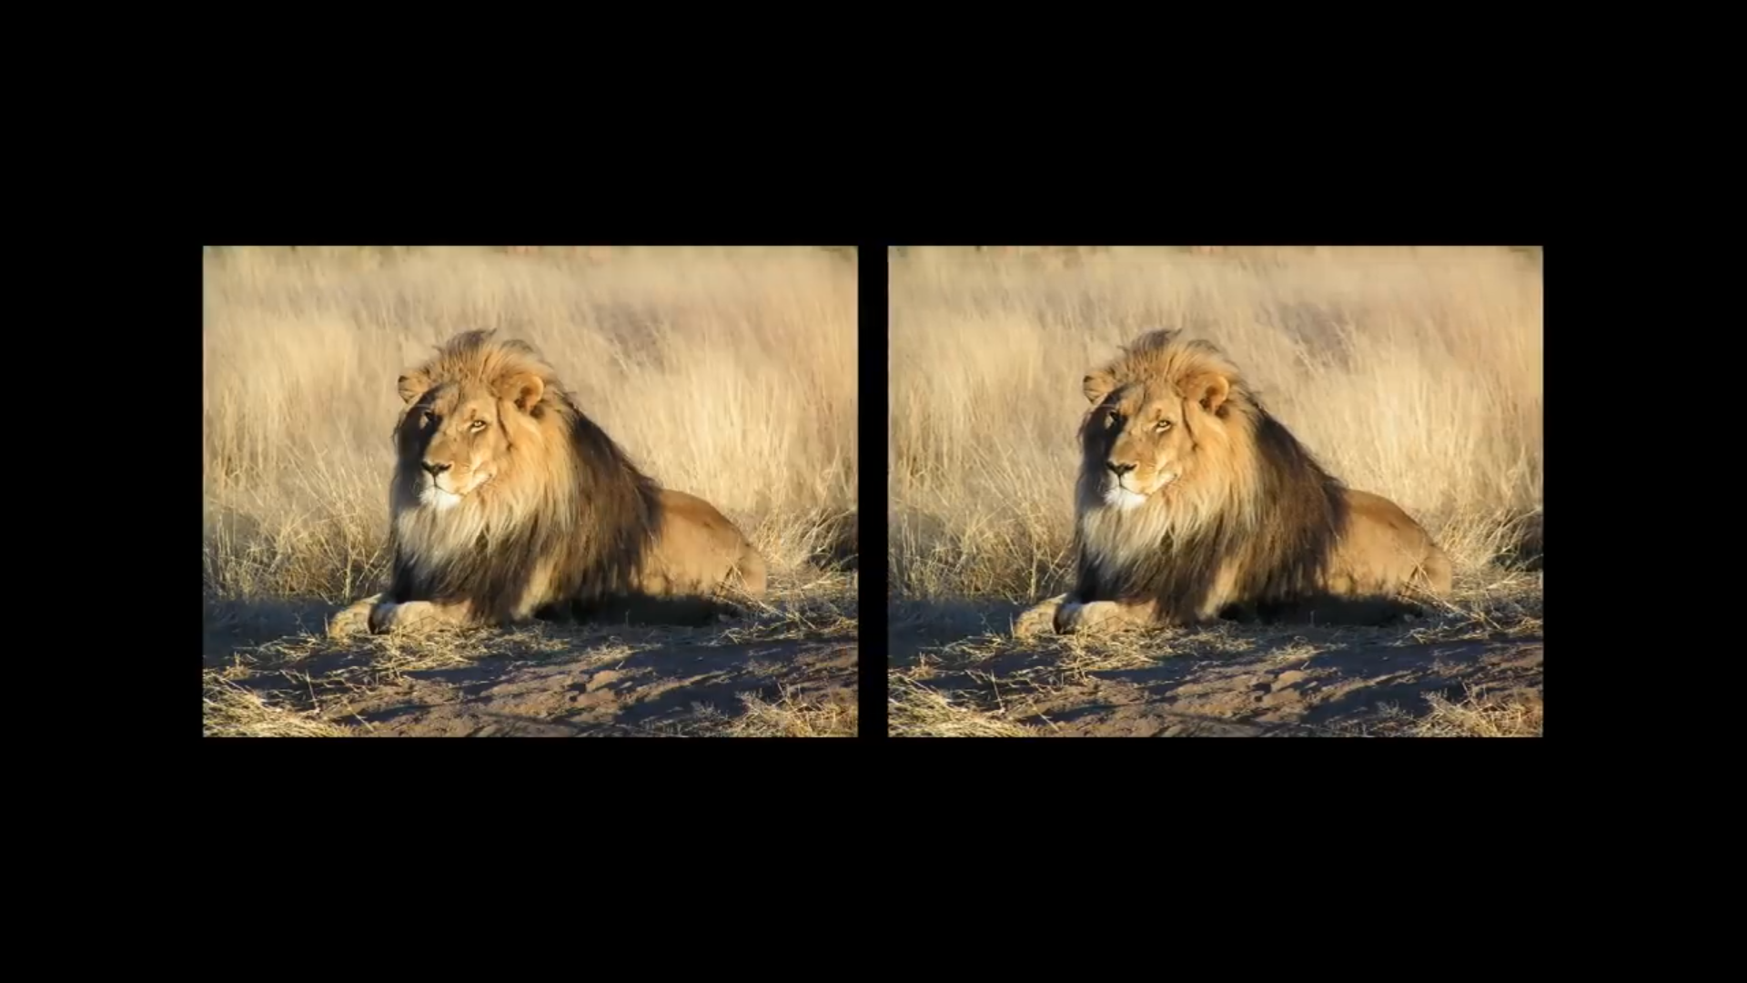

Slide 29
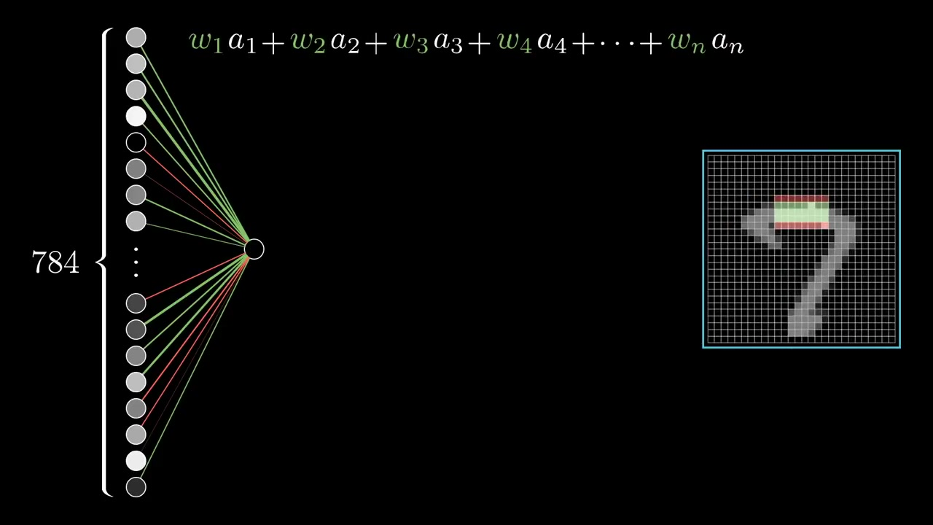
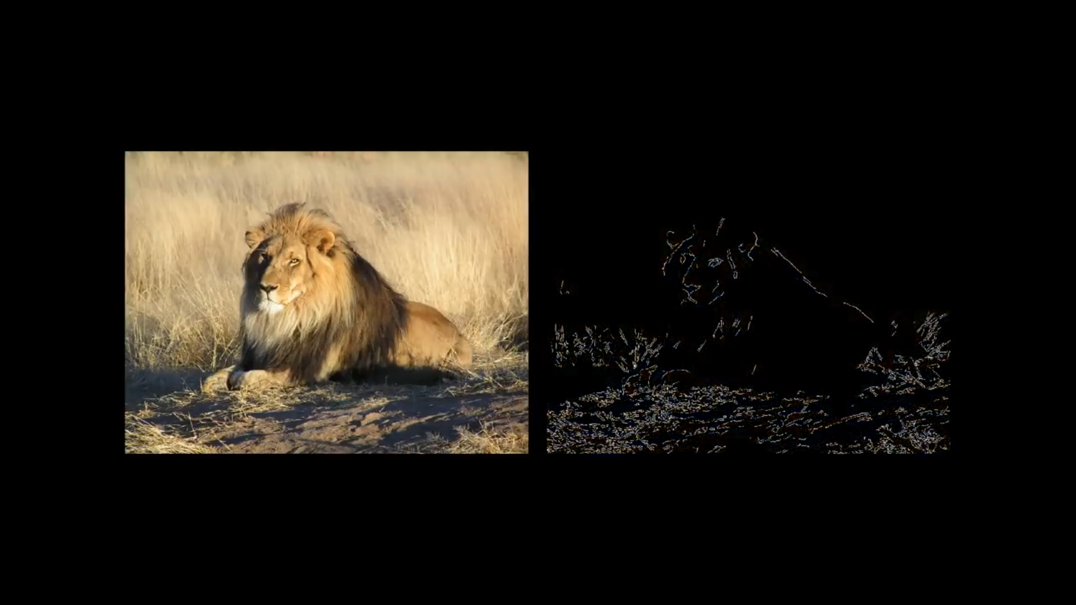

Slide 30
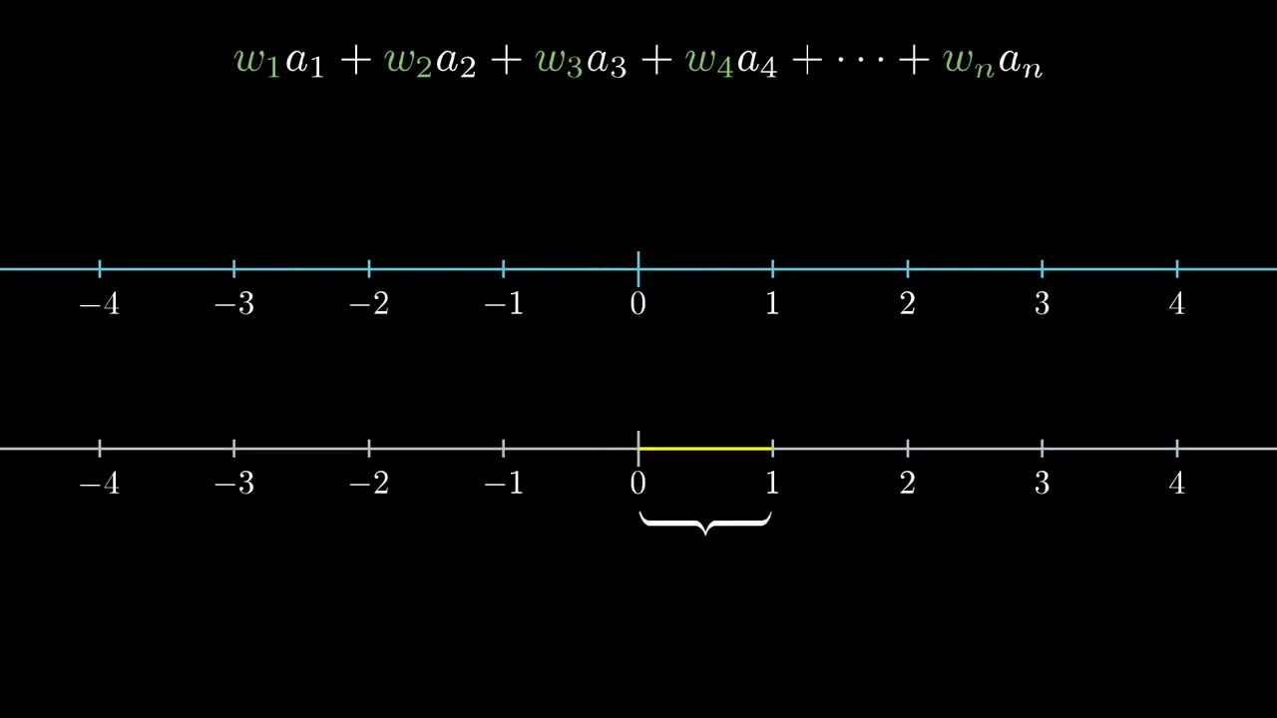

Slide 31
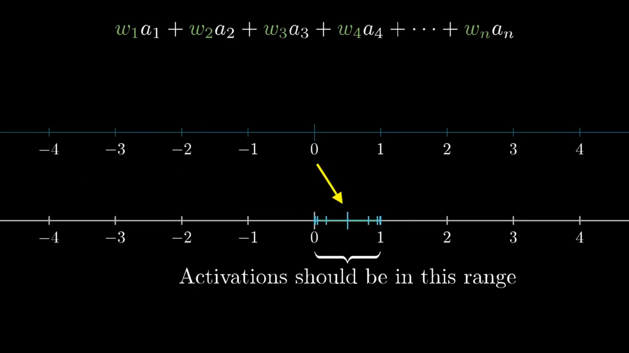

Slide 32
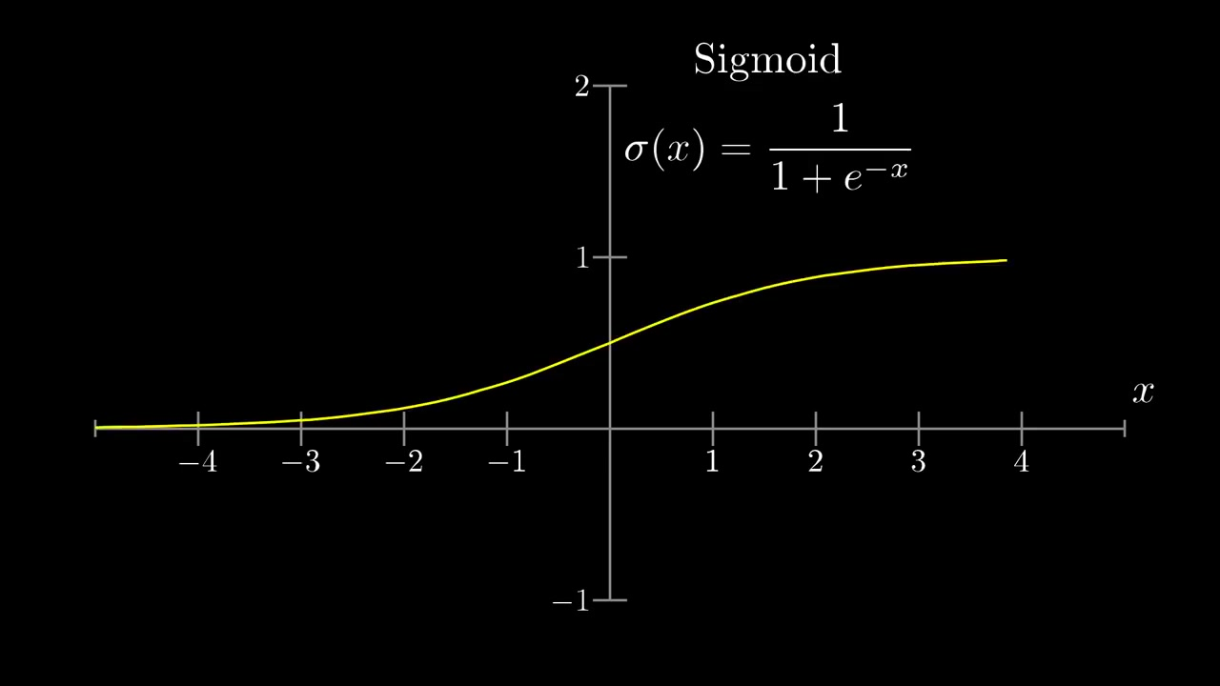

Slide 33
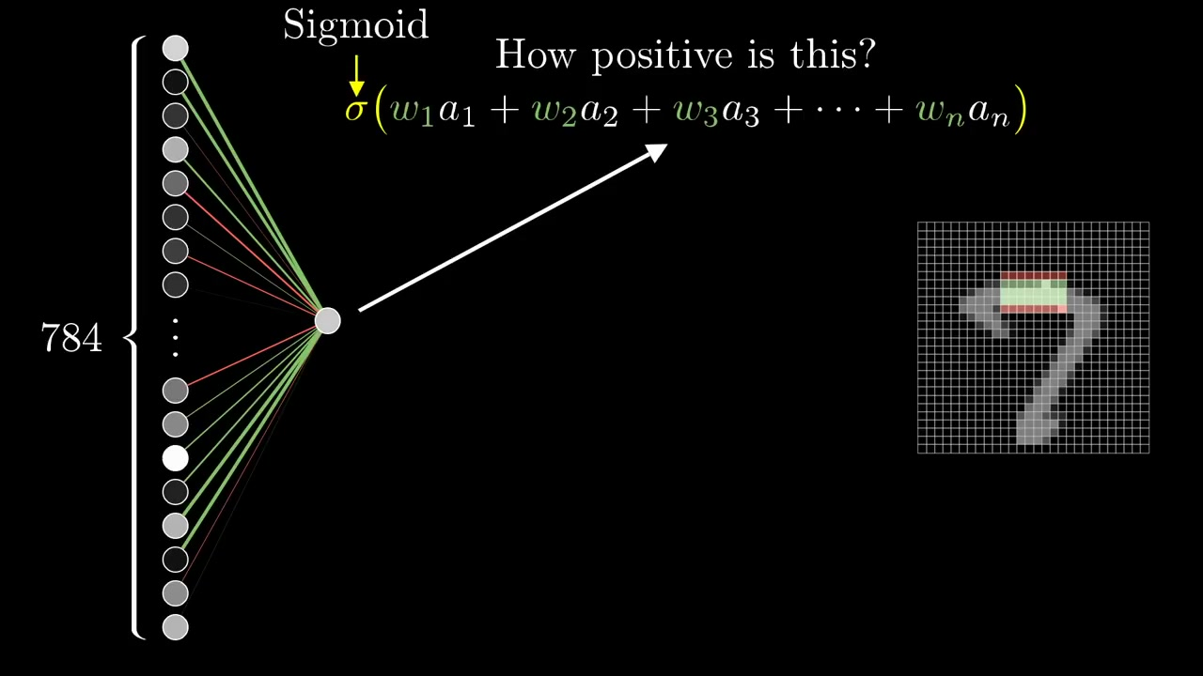

Slide 34
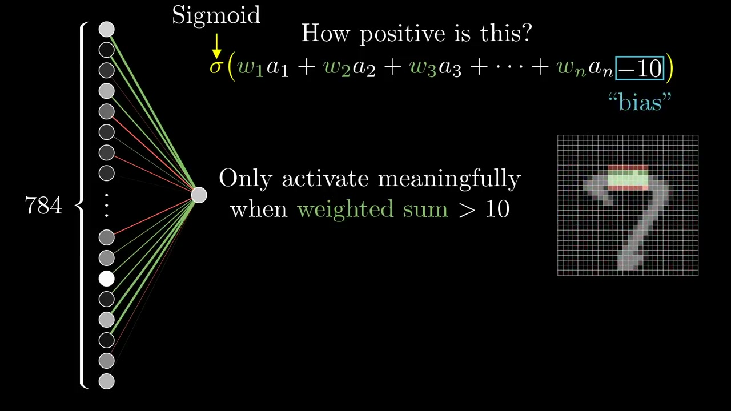

Slide 35
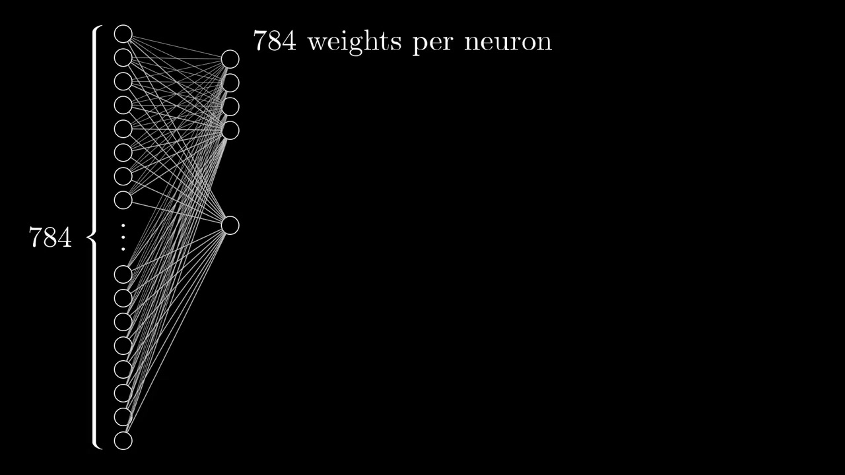

Slide 36
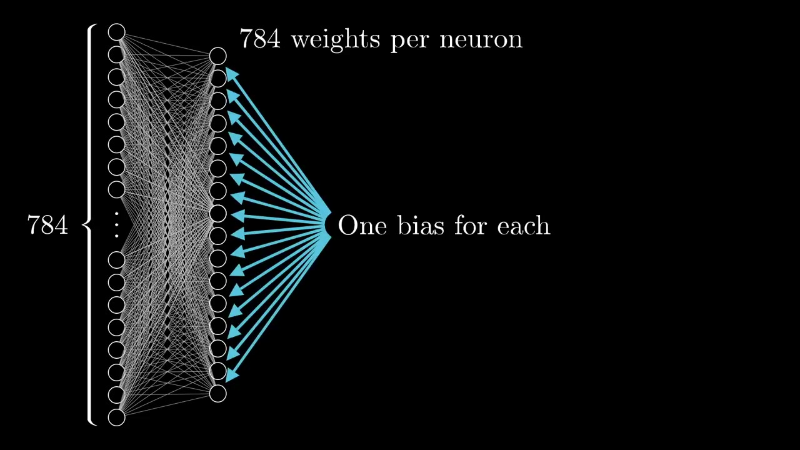

Slide 37
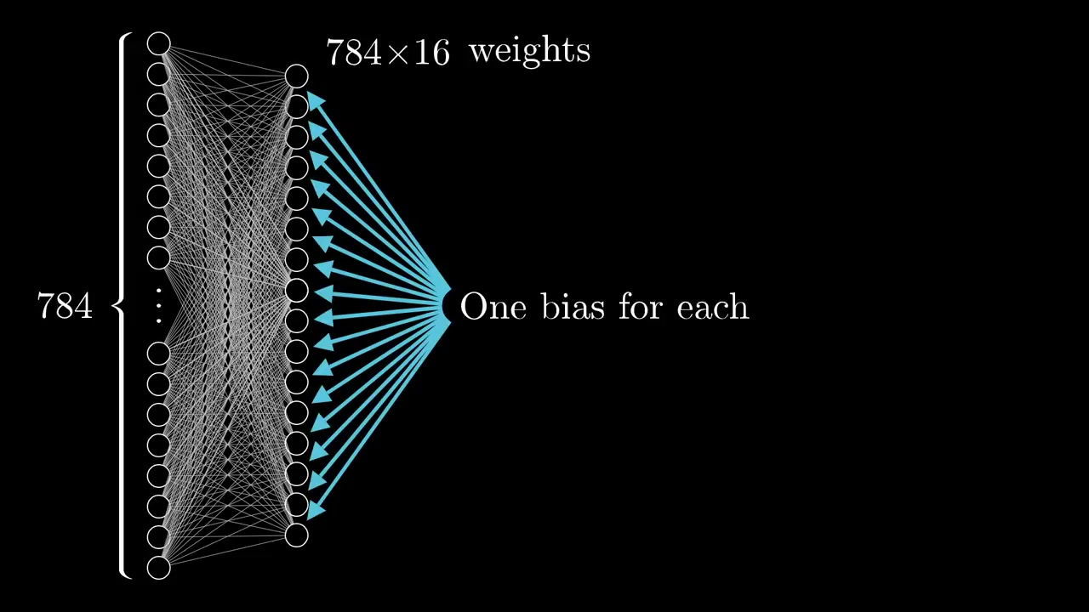

Slide 38
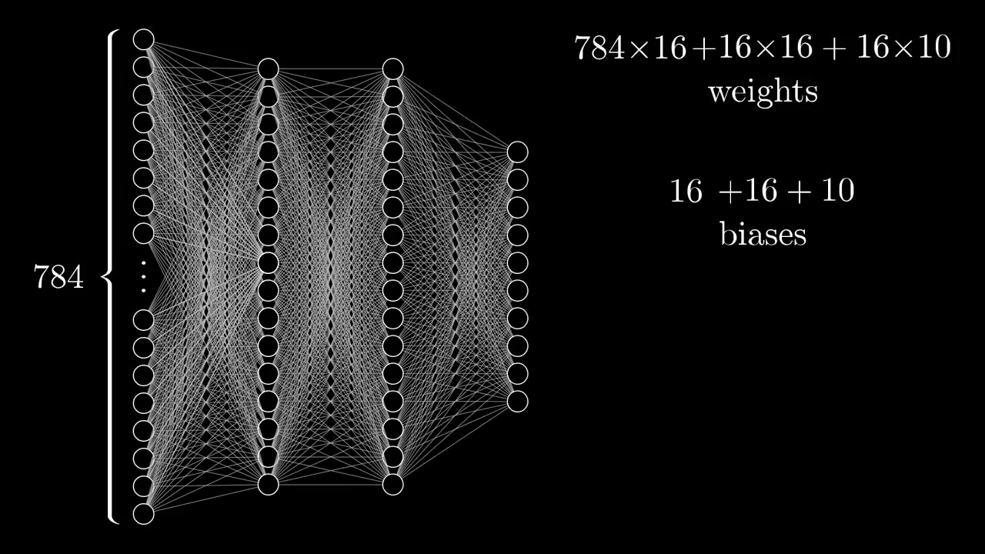

Slide 39
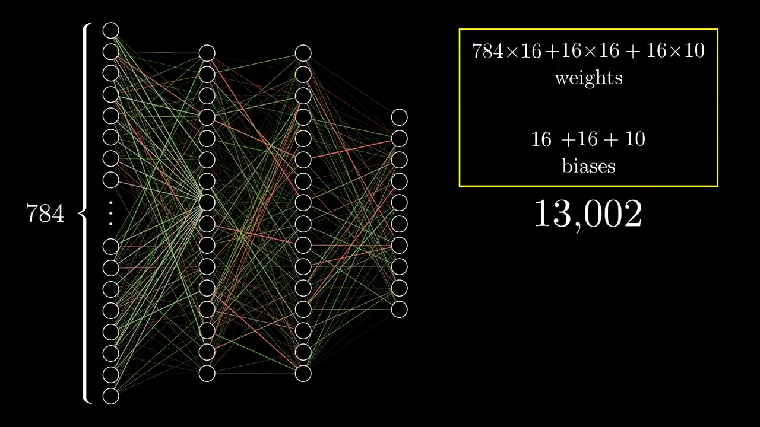

Slide 40
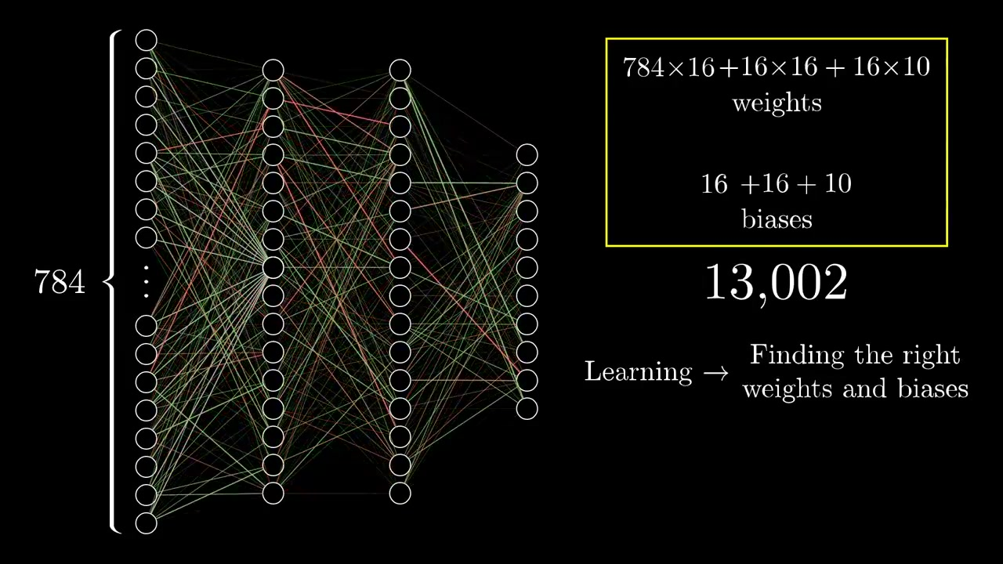

Slide 41
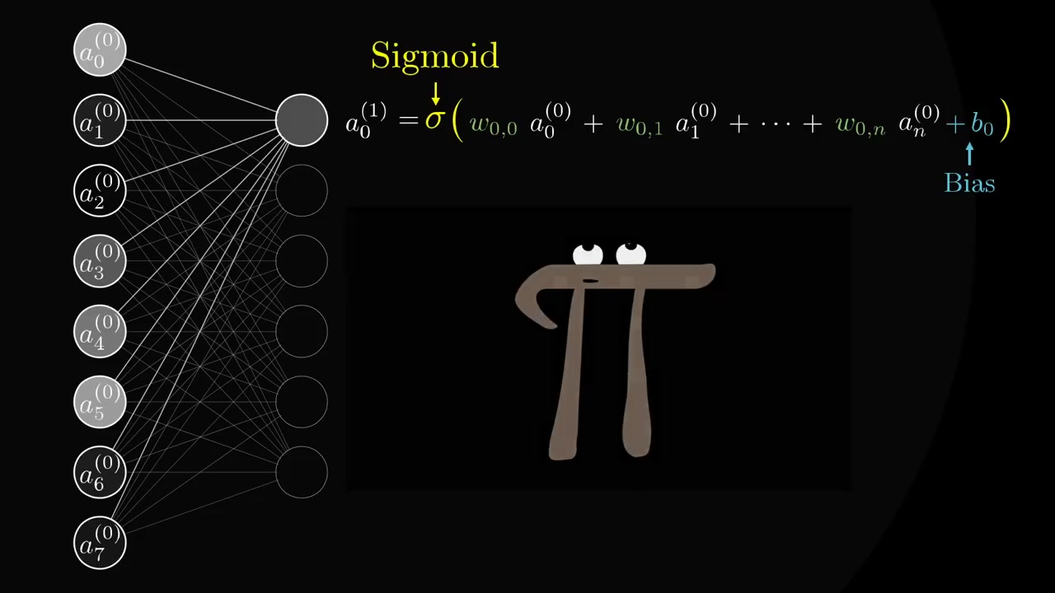

Slide 42
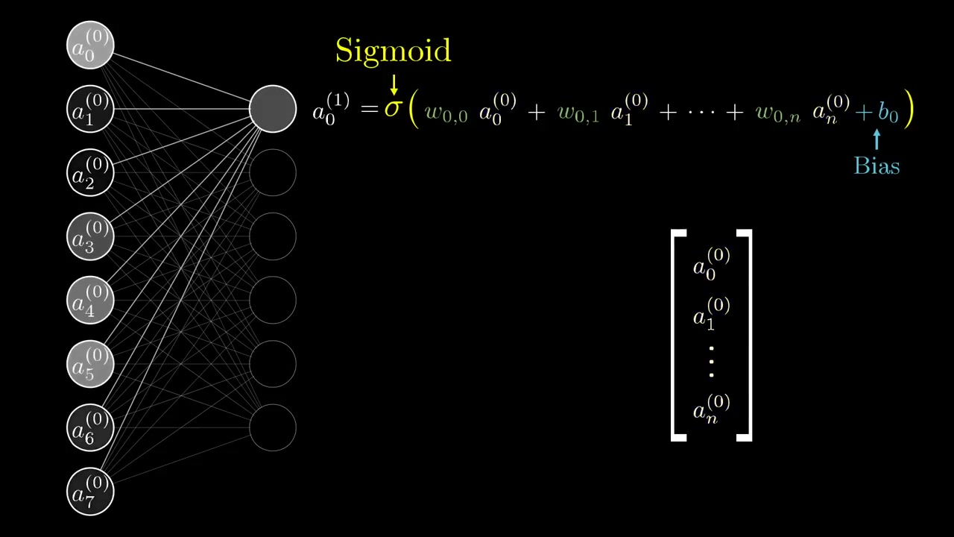

Slide 43
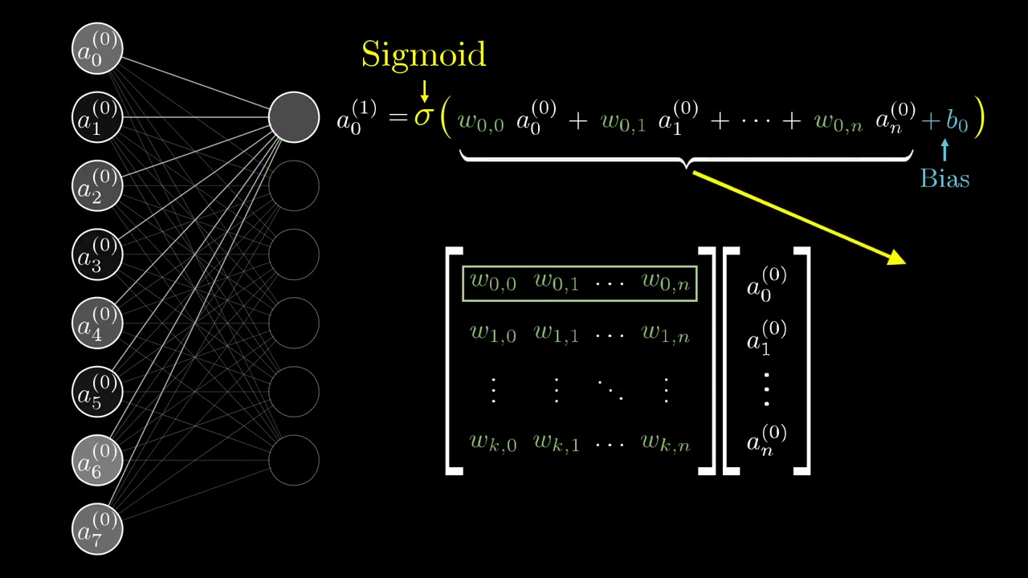

Slide 44
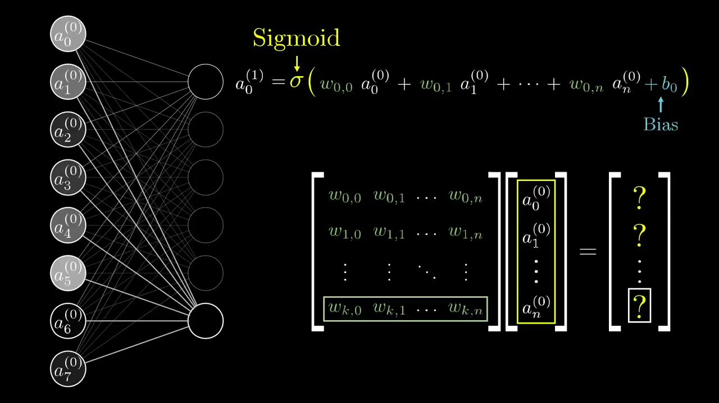

Slide 45
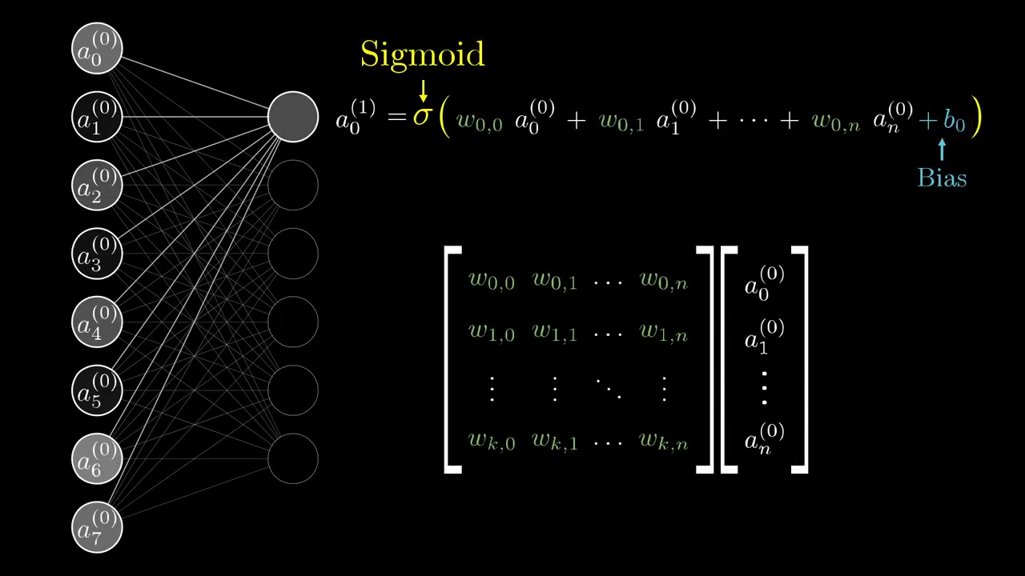

Slide 46
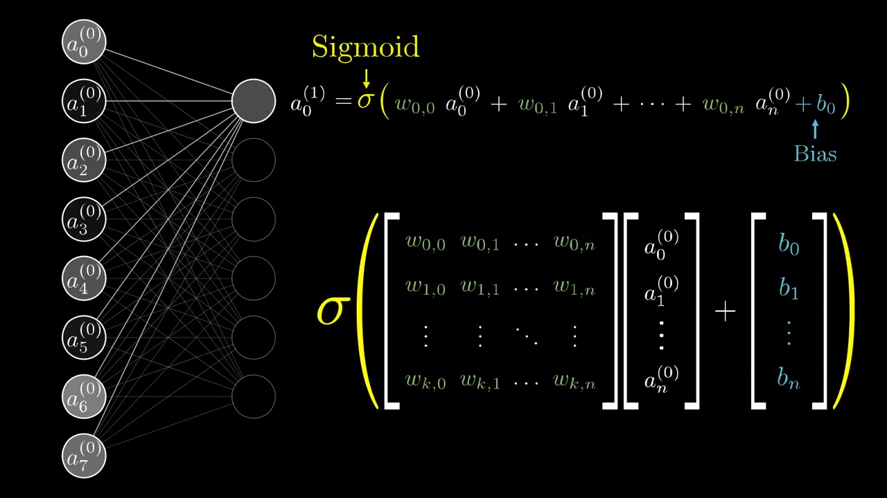

Slide 47
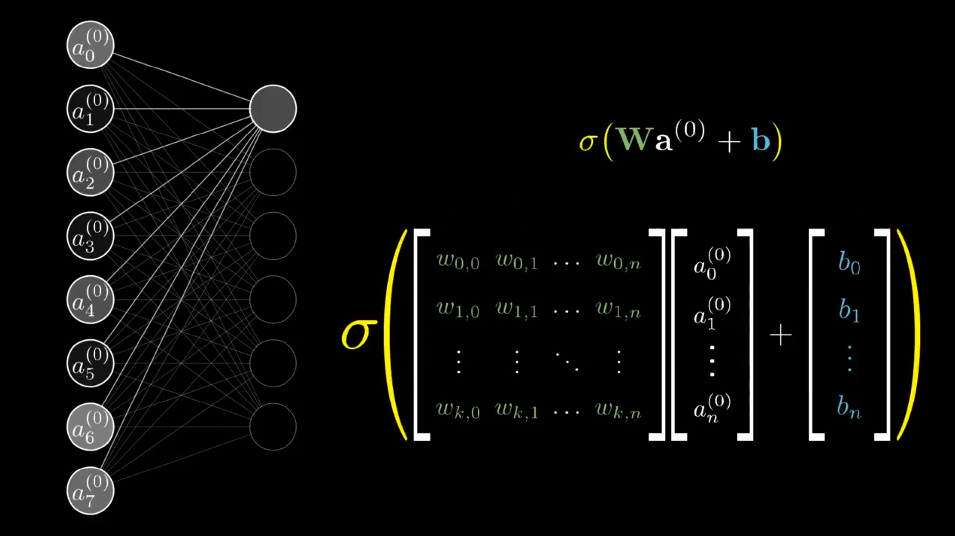

Slide 48
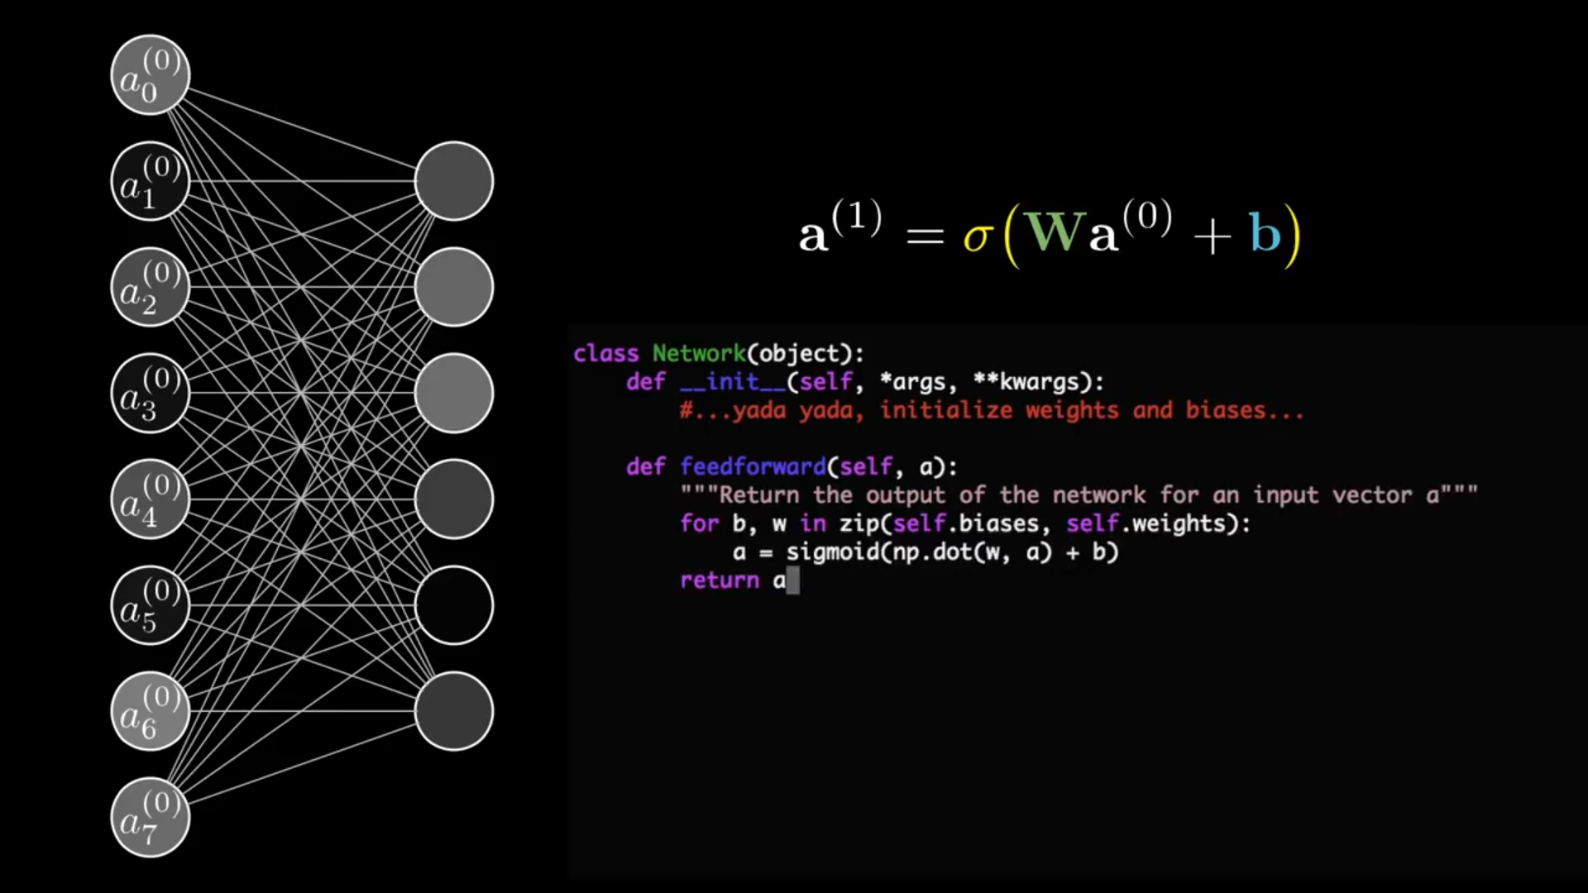

Slide 49
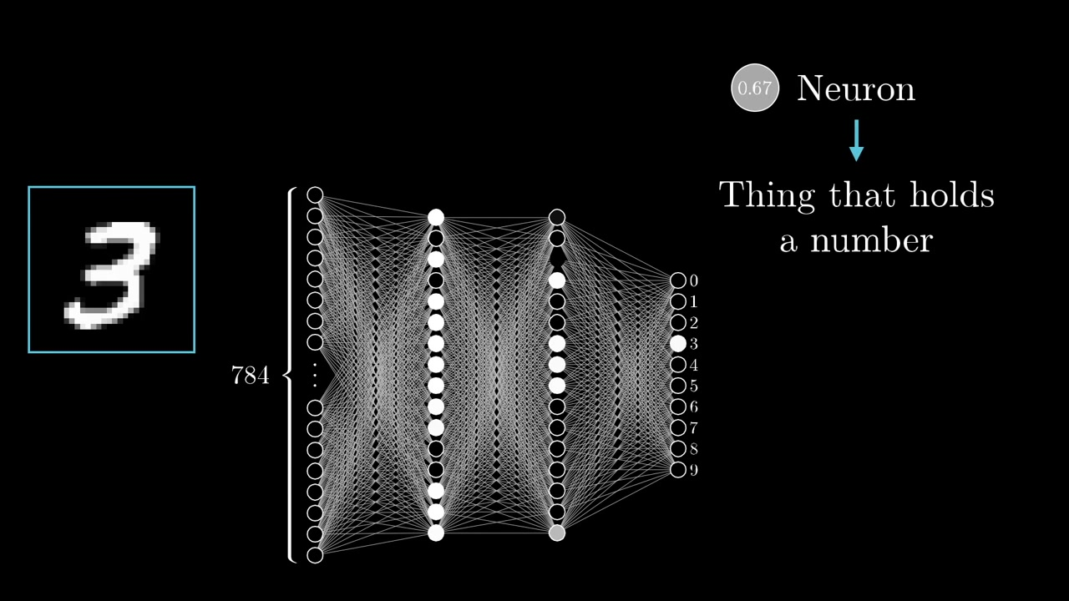

Slide 50
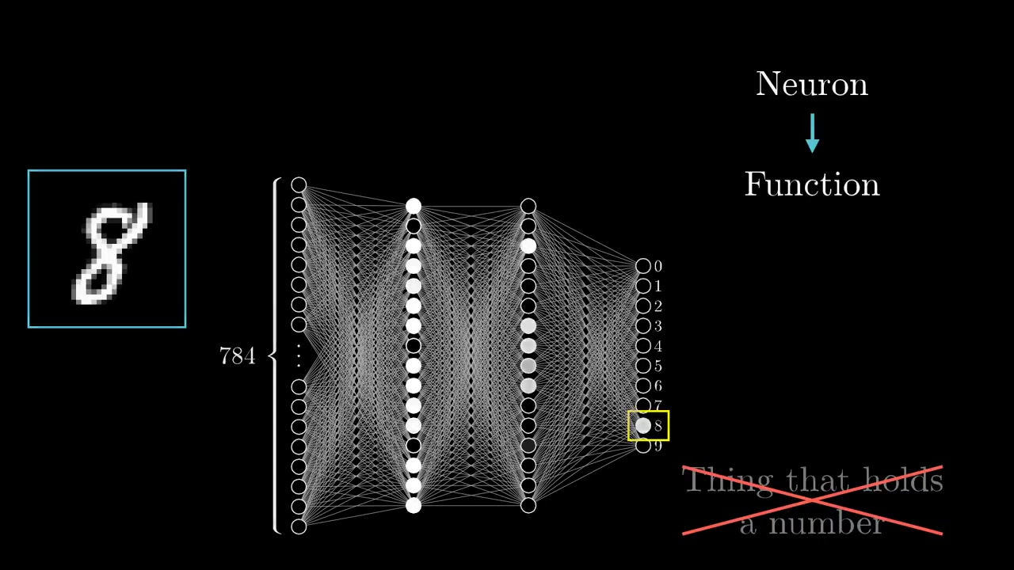

Slide 51
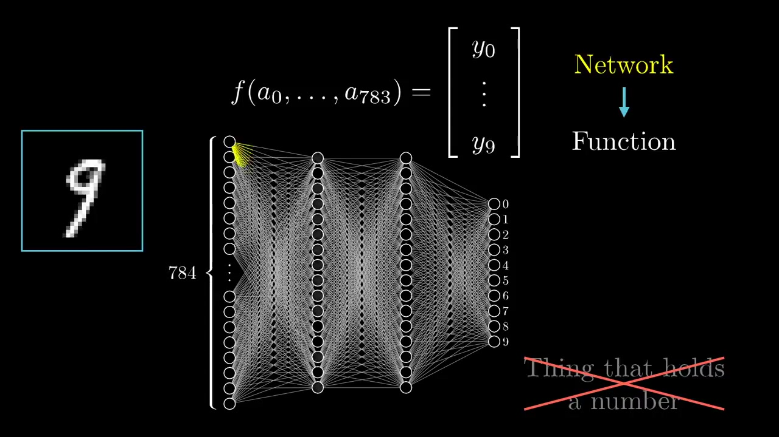

Slide 52
Activation Functions

Slide 53
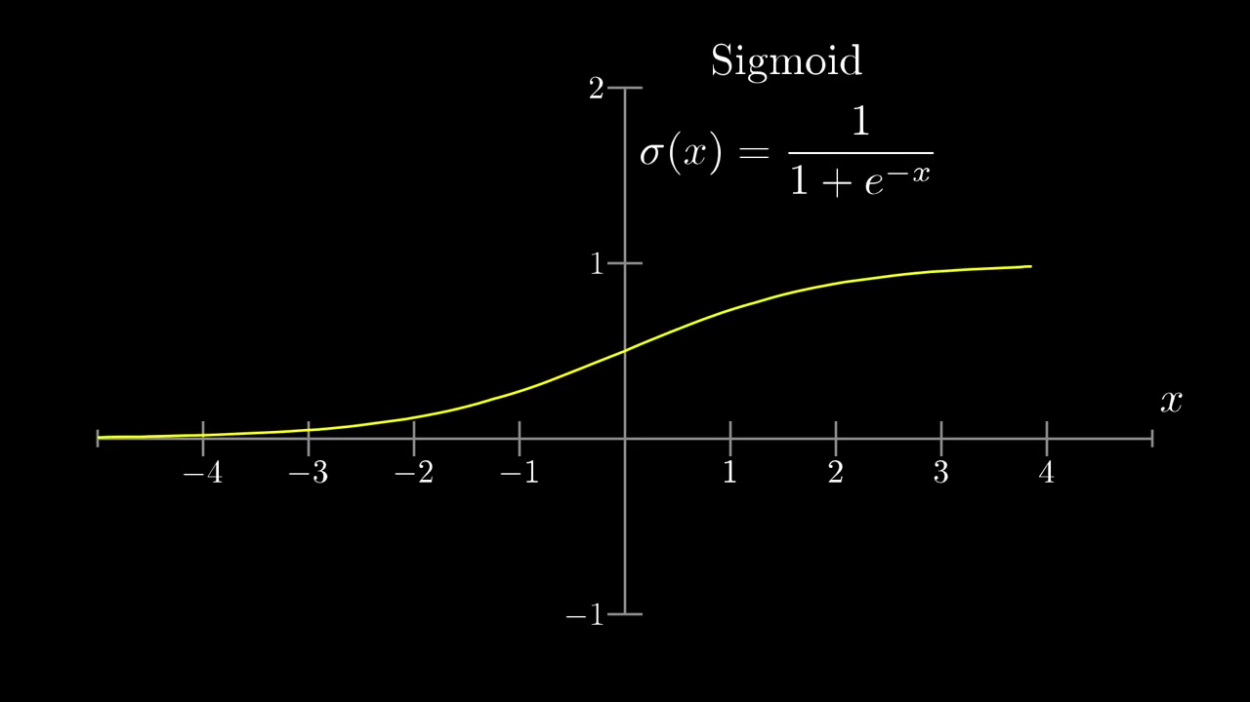

Slide 54
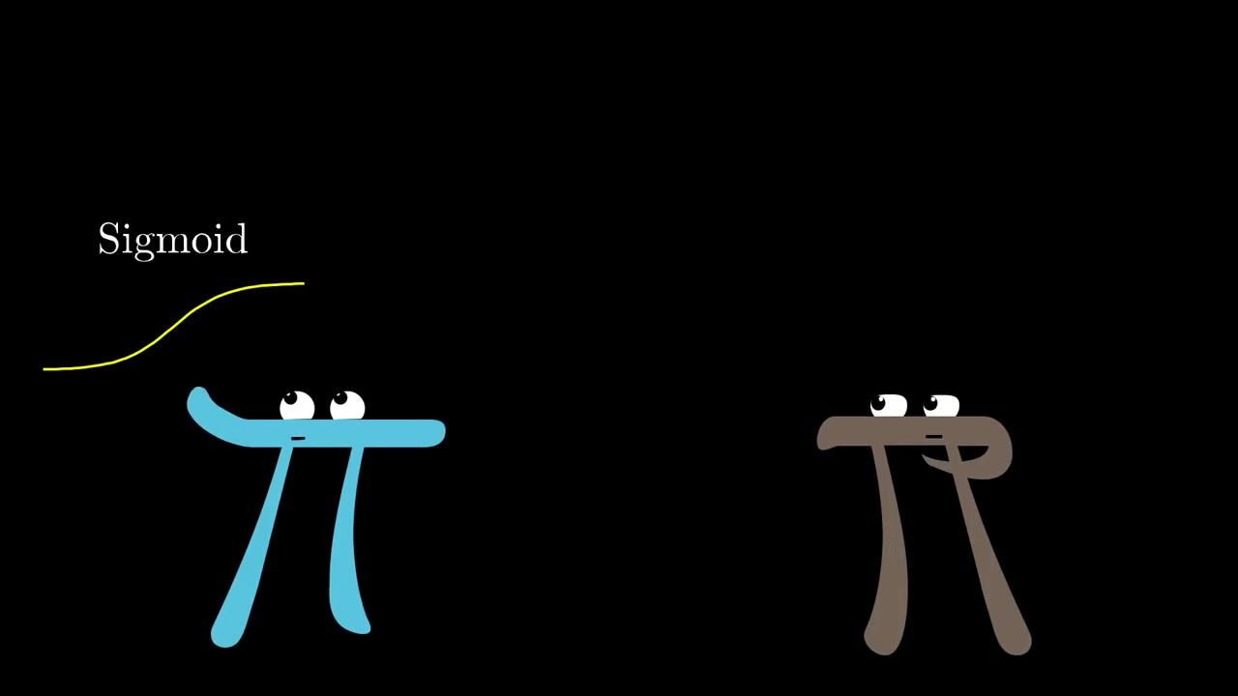

Slide 55


Slide 56


Slide 57


Slide 58
Agenda
Classifying handwritten digits using MLP
Feed Forward Network
Activation Functions
Cost Function and Gradient Calculation
Backpropagation
Convolutional Neural Network
Applications
Tools

Slide 59
Cost Function
Notes:
The first is to introduce the idea of gradient descent, which underlies not only how neural networks learn, but how a lot of other machine learning works as well
Then after that we're going to dig in a little more to how this particular network performs And what those hidden layers of neurons end up actually looking for
As a reminder our goal here is the classic example of handwritten digit recognition the hello world of neural networks these digits are rendered on a 28 by 28 pixel grid each pixel with some grayscale value between 0 & 1 those are what determine the activations of 784 neurons in the input layer of the network and
Then the activation for each neuron in the following layers is based on a weighted sum of All the activations in the previous layer plus some special number called a bias then you compose that sum with some other function like the sigmoid squishification or a ReLu
In total given the somewhat arbitrary choice of two hidden layers here with 16 neurons each the network has about 13,000 weights and biases that we can adjust and it's these values that determine what exactly the network you know actually does Then what we mean when we say that this network classifies a given digit
Is that the brightest of those 10 neurons in the final layer corresponds to that digit And remember the motivation that we had in mind here for the layered structure was that maybe The second layer could pick up on the edges and the third layer might pick up on patterns like loops and lines And the last one could just piece together those patterns to recognize digits So here we learn how the network learns What we want is an algorithm where you can show this network a whole bunch of training data which comes in the form of a bunch of different images of handwritten digits along with labels for what they're supposed to be and
It'll adjust those 13000 weights and biases so as to improve its performance on the training data Hopefully this layered structure will mean that what it learns
generalizes to images beyond that training data And the way we test that is that after you train the network You show it more labeled theta that it's never seen before and you see how accurately it classifies those new images

Slide 60


Slide 61


Slide 62


Slide 63


Slide 64


Slide 65


Slide 66


Slide 67


Slide 68


Slide 69


Slide 70


Slide 71


Slide 72


Slide 73


Slide 74


Slide 75


Slide 76

Notes:
Weights are strengths of those connections
Bias is an indication whether the neuron is active or inactive

Slide 77

Notes:
Needless to say, it is going to perform horribly

Slide 78


Slide 79


Slide 80


Slide 81


Slide 82

Notes:
Don’t explain yet

Slide 83


Slide 84


Slide 85


Slide 86


Slide 87


Slide 88


Slide 89


Slide 90


Slide 91


Slide 92


Slide 93


Slide 94


Slide 95


Slide 96


Slide 97


Slide 98

Notes:
Draw!

Slide 99

Notes:
Don’t Explain

Slide 100

Notes:
Don’t Explain

Slide 101


Slide 102


Slide 103


Slide 104


Slide 105


Slide 106


Slide 107


Slide 108


Slide 109


Slide 110


Slide 111


Slide 112


Slide 113


Slide 114


Slide 115


Slide 116


Slide 117


Slide 118


Slide 119


Slide 120


Slide 121


Slide 122


Slide 123


Slide 124


Slide 125


Slide 126

Notes:
Imagine our input

Slide 127


Slide 128


Slide 129

Now Imagine 13002 inputs in a incredibly huge input space.
Notes:
Use board to draw the 13002 column vector and show them how the gradient calculation is done.

Slide 130

Notes:
We need a smooth function to calculate gradient

Slide 131

Notes:
This is why neurons have continuous values instead binary on or off

Slide 132

Notes:
This process of repeatedly nudging the gradients is called gradient descent. Local Minimum of cost function.
This a 2 dimensional space, cuz a 13002 dimensional space is hard to imagine.

Slide 133

Notes:
Each gradient giv

Slide 134


Slide 135


Slide 136


Slide 137

Notes:
Bang for your buck
C(x,y) = 3/2 x^2 + ½ y^2

Slide 138


Slide 139


Slide 140
Not At All

Slide 141


Slide 142
Agenda
Classifying handwritten digits using MLP
Feed Forward Network
Activation Functions
Cost Function and Gradient Calculation
Backpropagation
Convolutional Neural Network
Applications
Tools

Slide 143
Backpropogation
The algorithm to calculate that crazy complicated gradient

Slide 144
Convolutional Neural Networks

Slide 145



Convolution
Used for the purpose of Feature Extraction
Preserves Spatial Information in an image
Input Image
Filter / Kernel
Feature Detector
Feature Map / Activation Map
Convolved Feature

Slide 146


Filters

Slide 147

Output of Convolution

Slide 148

Meet Non Linearity
ReLU is an element wise operation (applied per pixel) and replaces all negative pixel values in the feature map by zero.
Output = Max (zero, Input)

Slide 149

What ReLU Does to a Feature Map!

Slide 150

Pooling
Spatial Pooling (also called subsampling or downsampling) reduces the dimensionality of each feature map but retains the most important information.
Three Types :
Max
Average
Sum

Slide 151
Applications of Deep Learning

Slide 152


Slide 153


Slide 154


Slide 155


Slide 156


Slide 157


Slide 158


Slide 159


Slide 160


Slide 161


Slide 162


Slide 163


Slide 164


Slide 165


Slide 166


Slide 167


Slide 168


Slide 169


Slide 170


Slide 171


Slide 172


Slide 173


Slide 174


Slide 175


Slide 176


Slide 177


Slide 178


Slide 179


Slide 180


Slide 181


Slide 182


Slide 183


Slide 184
Tools

Slide 185
Comparison
CPU
GPU
Incredibly Flexible
Number of processing cores in the order of tens.
Operates on It’s own
Low Latency
Limited Operations
Number of processing cores in the order of thousands
Operated by CPU
High Latency

Slide 186

How do you measure speed?
How fast can you do one thing?
How much can you do per second?
Latency
Throughput
Throughput = Parallelism

Slide 187

Compute
Unified
Device
Architecture

Slide 188
CUDA
Extension of the C programming language.
CUDA allows the programmer to use Nvidia GPU to do general purpose computation

Slide 189
CUDNN
The NVIDIA CUDA® Deep Neural Network library (cuDNN) is a GPU-accelerated library of primitives for deep neural networks.
cuDNN provides highly tuned implementations for standard routines such as forward and backward convolution, pooling, normalization, and activation layers.

Slide 190


How Tensorflow Uses GPU
Under the hood, this transpose function op (operation) interface was defined in C++, in ops/array_ops.cc
Function Inputs : Tensor and a permutation of which dimensions to swap
Output of the Function
Shape function . This determines what the output Tensor

Slide 191

tf.transpose() Implementation
The important thing is that there are two separate implementations of ops, one for CPU and one for GPU.

